Slide 1
Web Development
HTML & CSS

Slide 2
Block level Elements
A block-level element always starts on a new line and takes up the full width available.
Examples of block-level elements:
<div>
<h1> - <h6>
<p>
<form>

Slide 3
Inline Elements
An inline element does not start on a new line and only takes up as much width as necessary.
Examples of inline elements:
<span>
<a>
<img>

Slide 4
More HTML Tags
<q> Defines a short inline quotation.
<img> Defines an image.
The <img> tag is empty, it contains attributes only, and does not have a closing tag.
The alt attribute provides an alternate text for an image.

Slide 5
More HTML Tags
<div> Defines a section in a document (block-level)
The <div> element is often used as a container for other HTML elements.
The <div> element has no required attributes, but both id and class are common.
<span> Defines a section in a document (inline)
The <span> element is often used as a container for some text.
The <span> element has no required attributes, but both id and class are common.
<iframe> Used to display a web page within a web page.
Very popular to add videos from YouTube or Vimeo on a page for instance.

Slide 6
HTML Entities
Some characters are reserved in HTML.
If you use the less than (<) or greater than (>) signs in your text, the browser might mix them with tags.
Character entities are used to display reserved characters in HTML.
To display a less than sign (<) we must write: &lt; or &#60;
A common character entity used in HTML is the non-breaking space: &nbsp;
A non-breaking space is a space that will not break into a new line.
More HTML entities examples:
& = &amp;
© = &copy;
® = &reg;

Slide 7

HTML Encoding
To display an HTML page correctly, a web browser must know which character set (character encoding) to use.
The default character encoding for HTML5 is UTF-8.
UTF-8 (Unicode) covers almost all of the characters and symbols in the world.
For HTML5
More about Character Set: Character Set Reference

Slide 8
HTML File Paths
A file path describes the location of a file in a web site's folder structure.
File paths are used when linking to external files like:
Web pages
Images
Style sheets
JavaScripts

Slide 9
HTML File Paths
Absolute File Paths
An absolute file path is the full URL to an internet file:
Relative File Paths
A relative file path points to a file relative to the current page.
In this example the file path points to a file in the images folder located at the root of the current web:

Slide 10
HTML File Paths
In this example the file path points to a file in the images folder located in the current folder:
In this example the file path points to a file in the images folder located in the folder one level above the current folder:

Slide 11
CSS
HTML was created to describe the content of a web page
CSS stands for Cascading Style Sheets.
“Describes how HTML elements are to be displayed on screen”
CSS can be added to HTML elements in 3 ways:
Inline - by using the style attribute in HTML elements
Internal - by using a <style> element in the <head> section
External - by using an external CSS file

Slide 12
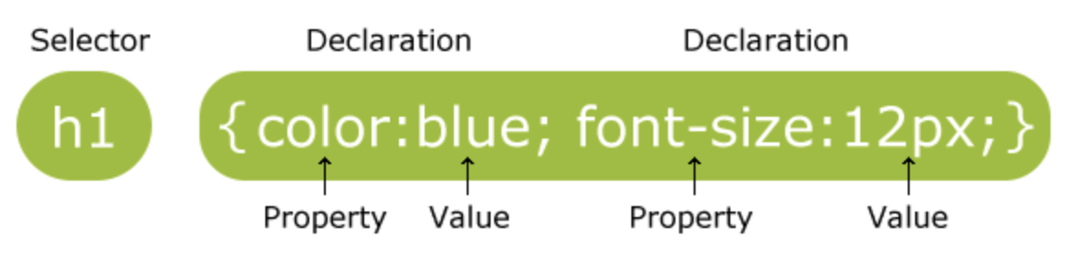
CSS Syntax and Selectors
The selector points to the HTML element you want to style.
The declaration block contains one or more declarations separated by semicolons.
Each declaration includes a CSS property name and a value, separated by a colon.
A CSS declaration always ends with a semicolon, and declaration blocks are surrounded by curly braces.

Slide 13
Inline CSS
An inline CSS is used to apply a unique style to a single HTML element.
An inline CSS uses the style attribute of an HTML element.

Slide 14
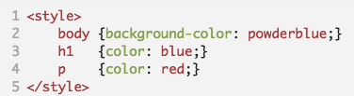
Internal CSS
An internal CSS is used to define a style for a single HTML page.
An internal CSS is defined in the <head> section of an HTML page, within a <style> element.

Slide 15

External CSS
An external style sheet is used to define the style for many HTML pages.
With an external style sheet, you can change the look of an entire web site, by changing one file!
To use an external style sheet, add a link to it in the <head> section of the HTML page.
The file must not contain any HTML code, and must be saved with a .css extension.

Slide 16
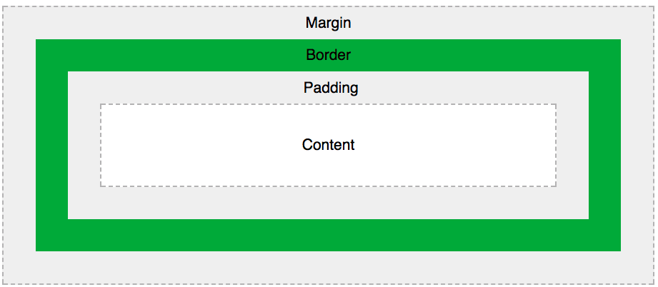
CSS Box Model
“All HTML elements can be considered as boxes.”
The CSS box model is essentially a box that wraps around every HTML element.

Slide 17
CSS Box Model
Explanation of the different parts:
Content - The content of the box, where text and images appear
Padding - Clears an area around the content. The padding is transparent
Border - A border that goes around the padding and content
Margin - Clears an area outside the border. The margin is transparent

Slide 18
Element Size? Content Size?
In order to set the width and height of an element correctly in all browsers, you need to know how the box model works.
Important: When you set the width and height properties of an element with CSS, you just set the width and height of the content area. To calculate the full size of an element, you must also add padding, borders and margins.

Slide 19
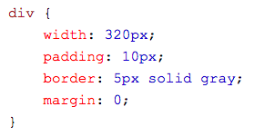
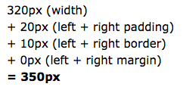
Element Size Example
Width?

Slide 20
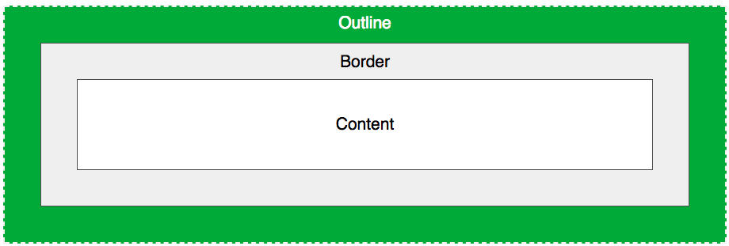
CSS Outline
The CSS outline properties specify the style, color, and width of an outline.
An outline is a line that is drawn around elements (outside the borders) to make the element "stand out".
However, the outline property is different from the border property - The outline is NOT a part of an element's dimensions; the element's total width and height is not affected by the width of the outline.

Slide 21
CSS Properties...
The color property is used to set the color of the text.
The height and width properties are used to set the height and width of an element.
The CSS border properties allow you to specify the style, width, and color of an element's border.
The CSS margin properties are used to generate space around elements.
The CSS padding properties are used to generate space around content.
The background-color property specifies the background color of an element.
The background-image property specifies an image to use as the background of an element.
The text-align property is used to set the horizontal alignment of a text.
The font family of a text is set with the font-family property.
The font-size property sets the size of the text.
And many more...

Slide 22

Font Size ( px, em, %)
Setting the text size with pixels(px) gives you full control over the text size.
To allow users to resize the text (in the browser menu), many developers use em instead of pixels.
The em size unit is recommended by the W3C.
1em is equal to the current font size. The default text size in browsers is 16px. So, the default size of 1em is 16px. ( px / 16 = em)

Slide 23
References
www.w3schools.com

